Slide 1

News Bias Assessment:
Examining subjective intensifiers
Claire McLean
CAM685@pitt.edu
University of Pittsburgh
1

Slide 2

Table of
CONTENTS
01
02
03
04
Background
Literature Review: Operationalizing linguistic bias
Research Questions
Methods and Procedures
05
06
07
08
The Data
Some Analyses and Figures
Next Steps
Citations
2

Slide 3
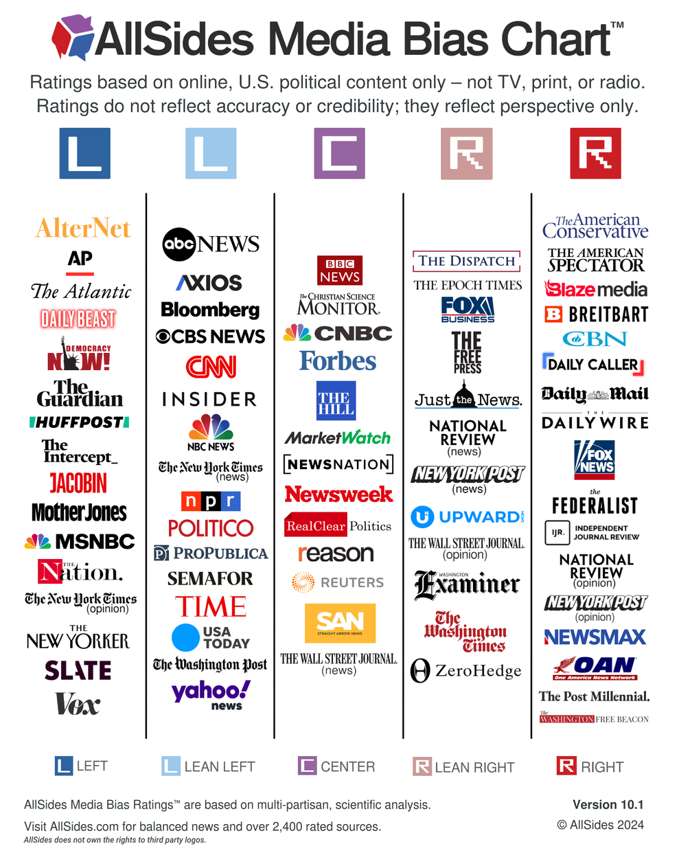

BACKGROUND
Many of us have different perceptions of the level and direction of bias in different U.S. news sources
Starting framework: AllSides Media Bias Chart
Assesses bias, not accuracy in reporting
Based on input from ‘ordinary’ Americans and experts combined
Not AI-based
Selected one source from the ‘Left’ side and one from the ‘Right’ side
Vox (left)
Fox (right)
3

Slide 4

LITERATURE REVIEW
How can we operationalize bias in a linguistic way?
Linguistic Models for Analyzing and Detecting Biased Language (Recasens, et. al, 2013)
Framing bias: subjective or one-sided terms reveal author’s stance on a topic
Factive verbs
One-sided terms
Subjective intensifiers
a) Schnabel himself did the fantastic reproductions of Basquiat’s work.
b) Schnabel himself did the accurate reproductions of Basquiat’s work.
Intensification for discursive evaluation: a corpus-pragmatic view (Pan, 2021)
Words like ‘very’, ‘so’, and ‘really’ add social and emotion-driven emphasis to utterances
Construction: Intensifier + adjective
Corpus: BNC Sampler
Tagset: CLAWS7 (degree adverbs / RG)
For the purposes of this project, I decided to analyze the top 4 degree adverbs (subjective intensifiers) from (Pan, 2021) within my own corpus. These were ‘very’, ‘so’, ‘quite’, and ‘too’.
4

Slide 5

RESEARCH QUESTIONS
How do the frequencies of subjective intensifier constructions in the standard news articles compare to ‘unbiased’ text?
01
Is there a significant difference in the prevalence of subjective intensifiers between the standard news articles and the ‘opinion’ articles from the same sources?
02
5

Slide 6

Step 1: Identify key subjective intensifiers and select news sources for analysis
Step 2: Create the following lists of data:
25 Fox News URLs
25 Fox News Opinion URLs
25 Vox URLs
25 Vox (The Big Idea) URLs
Brown Corpus (unbiased?)
Step 3: Scrape websites
BeautifulSoup
Step 4: Data cleaning
Built some cleaning into web scraper
Headline, (subheading), text, source
Step 5: Linguistic analysis
Step 6: Statistical analysis
METHODS AND PROCEDURES
6

Slide 7
Fox News
THE DATA
Standard:
20,442 tokens
20,417 bigrams
Opinion:
25,385 tokens
25,360 bigrams
25 of most recent articles were taken directly from the 'Politics' page of each news source.
(These were not chosen based on any criteria except for their ability to be scraped by the parser I created.)
25 'Opinion' articles were also taken from each of the same sources.
Vox
Standard:
31,689 tokens
31,664 bigrams
Opinion:
48,751 tokens
48,726 bigrams
7

Slide 8

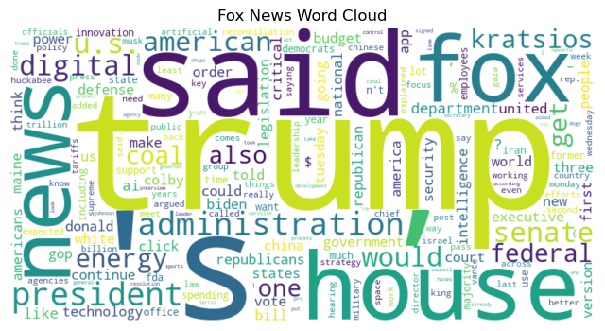
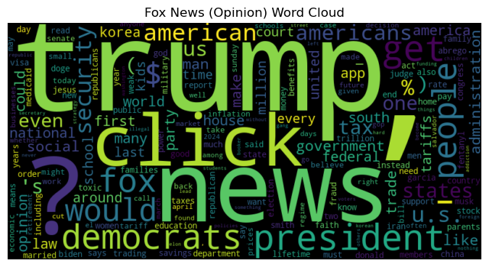
FOX NEWS
8

Slide 9
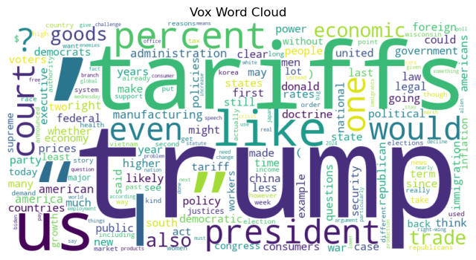
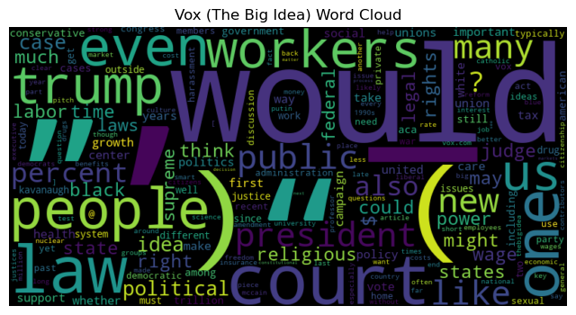
VOX
9

Slide 10
Bigram Frequency Distributions
Fox News bigram frequency distribution (top 10)
Vox bigram frequency distribution (top 10)
{('&', 'nbsp'): 207, ('nbsp', ';'): 207, ('.', '``'): 145, (',', "''"): 137, ('’', 's'): 91, ('of', 'the'): 88, (',', 'and'): 80, ('fox', 'news'): 79, ('in', 'the'): 72, ('to', 'the'): 71}
{('’', 's'): 492, (',', 'and'): 159, ('in', 'the'): 130, ('trump', '’'): 127, ('of', 'the'): 121, (',', 'the'): 112, ('.', 'the'): 98, ('’', 't'): 82, ('.', 'and'): 74, ('.', 'but'): 72}
Fox News Opinion bigram frequency distribution (top 10)
Vox (The Big Idea) bigram frequency distribution (top 10)
{('&', 'nbsp'): 675, ('nbsp', ';'): 675, ('’', 's'): 179, ('in', 'the'): 84, ('’', 't'): 76, (',', 'and'): 76, ('of', 'the'): 68, (',', 'the'): 63, ('click', 'here'): 61, ('.', 'the'): 58}
{('’', 's'): 425, ('of', 'the'): 318, (',', 'and'): 245, ('in', 'the'): 194, ('.', 'the'): 189, (',', 'the'): 183, ('to', 'the'): 120, ('.', 'but'): 107, ('’', 't'): 103, ('on', 'the'): 100}
10

Slide 11
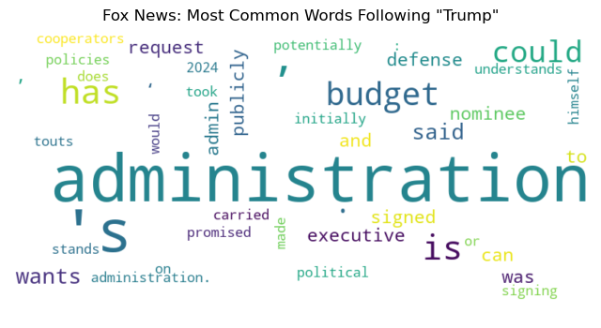
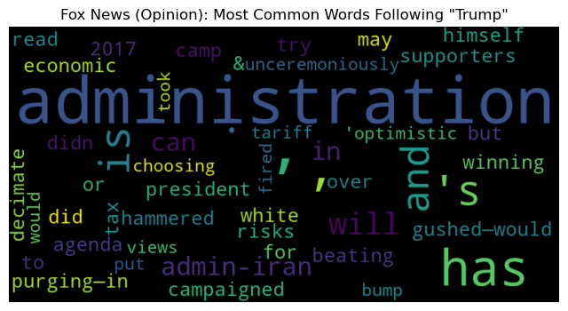
FOX NEWS CFD: WORDS FOLLOWING ‘TRUMP’
11

Slide 12
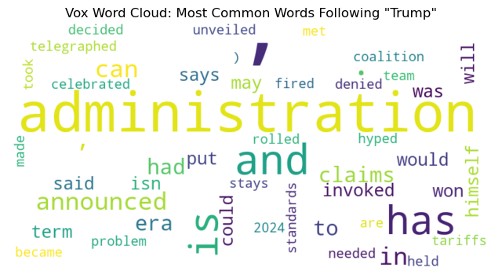
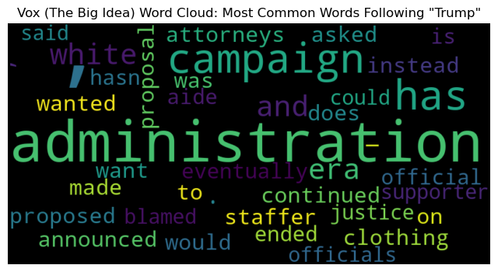
VOX CFD: WORDS FOLLOWING ‘TRUMP’
12

Slide 13
NEXT STEPS
TAG BIGRAMS
IDENTIFY SUBJECTIVE CONSTRUCTIONS IN ALL CORPORA
COMPARE SUBJECTIVE CONSTRUCTION FREQUENCIES BETWEEN TEXTS
Necessary to identify subjective intensifiers that are followed by adjectives
This will be accomplished through conditional frequency distributions. Finding ADJ words that follow each of the 4 intensifiers
13

Slide 14
REFERENCES
Recasens, M., Danescu-Niculescu-Mizil, C., & Jurafsky, D. (2013). Linguistic Models for Analyzing and Detecting Biased Language. Proceedings of the 51st Annual Meeting of the Association for Computational Linguistics, 1650–1659
Pan, Y. (2022). Intensification for discursive evaluation: a corpus-pragmatic view. Text & Talk, 42(3), 391-417.
14

